Slide 1
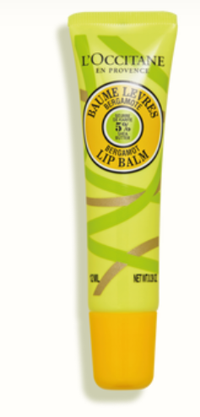
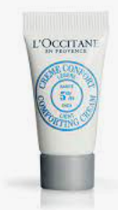

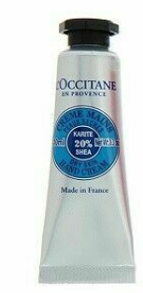
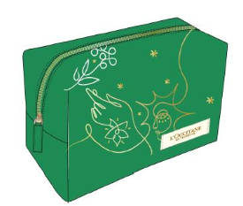
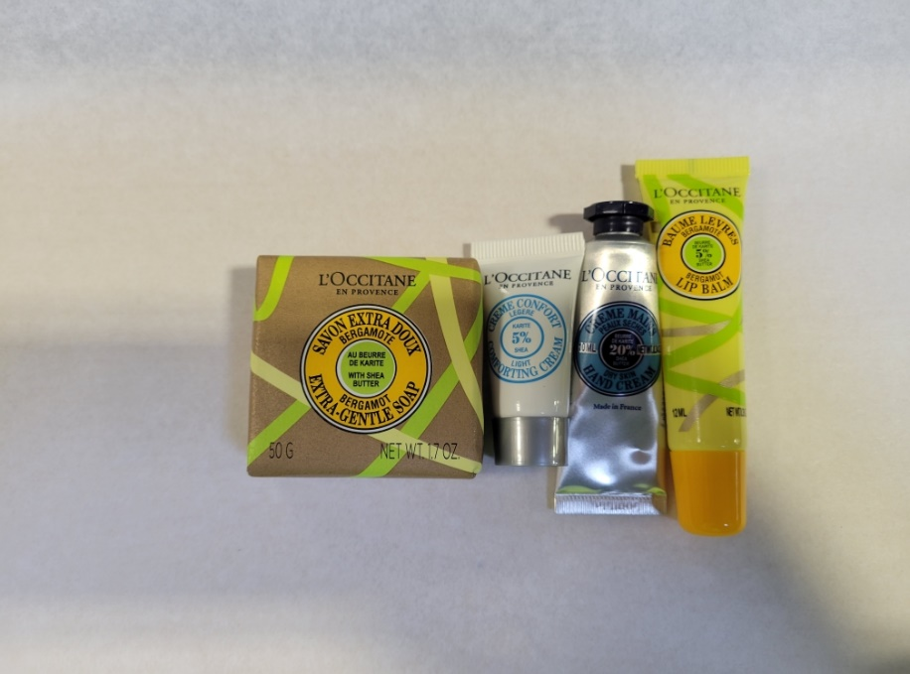
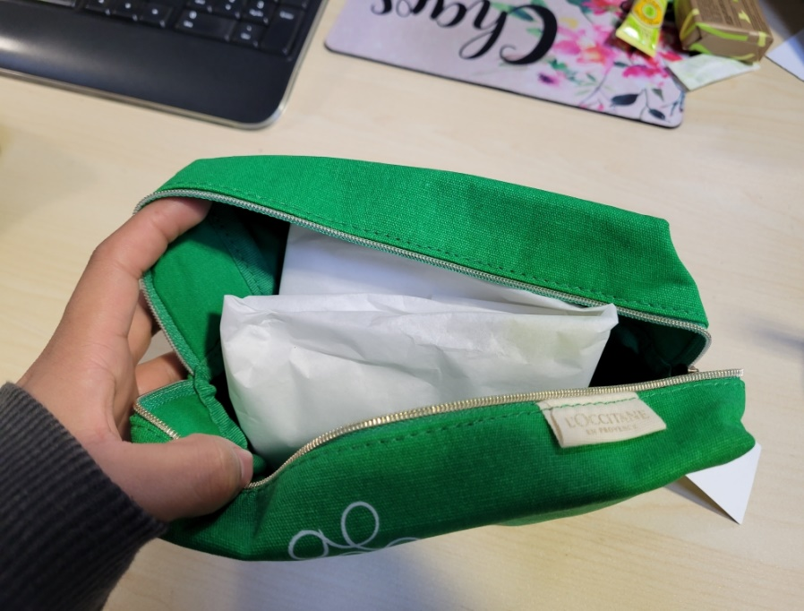
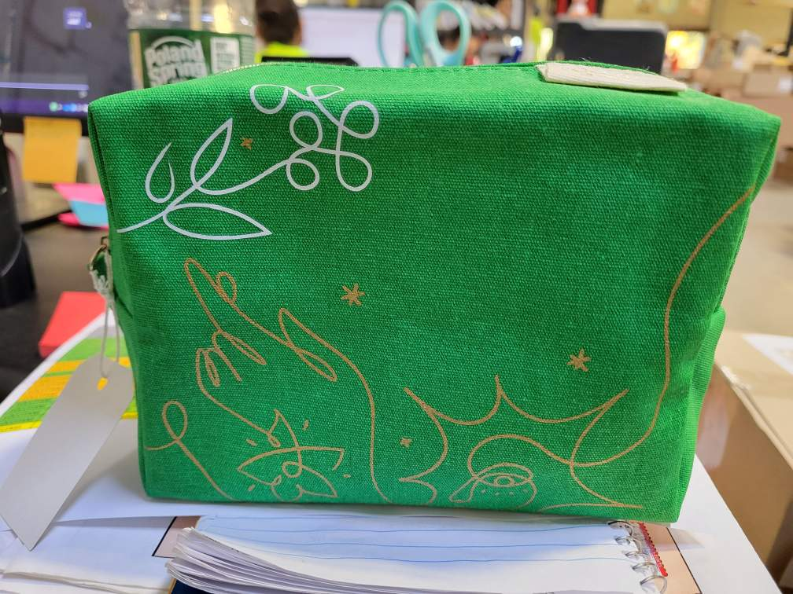
NAOCVKI003076 | 2022_SHEA JAN CAMPAIGN GWP_RT
01BL012B20H | SHEA SCENTED LIP BALM 12ML
49CL003K16 | SHEA LIGHT FACE CREAM 3ML
01SA050B20H | SHEA SOLID SOAP 50GR
49MA010K16 | SHEA HAND CREAM 10ML
49BF1N020 | 2020 HOLIDAY BLACK FRIDAY 1
52MOCOL116 | GEN SILK PAPER COLOR 1 16X480
DC BARCODE | DC BARCODE
3253581744673
Products
Box
Tissue x 1
DC Barcode
1. Grab one sheet of tissue and place the items as below.
2. Wrap the item in the tissue and place it inside the pouch.
3. Close pouch and add barcode label.

